Slide 1
Privacy Enhancing Technologies (PETs) and Zero Knowledge Proofs
Eray ALTILI
04/27/2022

Slide 2
What are privacy-enhancing technologies (PETs)?
Privacy-enhancing technologies (PETs) are a broad range of technologies (hardware or software solutions) that are designed to extract data value in order to unleash its full commercial, scientific and social potential, without risking the privacy and security of this information.

Slide 3
Why PETs are important
Like any other data privacy solution, privacy-enhancing technologies are important due to three reasons for businesses:
Data protection laws such as GDPR and CCPA are forcing organizations to preserve consumer data. Businesses can pay serious fines because of data breaches. These fees are already being levied, according to DLA Piper GDPR Data Breach Survey 2020, GDPR fines are over US$126 million from May 2018 to January 2020.
Data may need to be tested by third-party organizations due to the lack of your business’ self-sufficiency in analytics and application testing. PETs enable privacy protection while data sharing.
Privacy breaches can harm your business’ reputation, businesses or customers (depending on your business model) may want to stop interacting with your brand. An example is the share price loss of Facebook after Cambridge Analytica scandal.

Slide 4
What are common PETs
Cryptographic Algorithms 1
Homomorphic Encryption: Homomorphic encryption is an encryption method that enables computational operations on encrypted data. It generates an encrypted result which, when decrypted, matches the result of the operations as if they had been performed on unencrypted data (i.e., plaintext). This enables encrypted data to be transferred, analyzed and returned to the data owner who can decrypt the information and view the results on the original data. Therefore, companies can share sensitive data with third parties for analysis purposes. It is also useful in applications that hold encrypted data in cloud storage. Some common types of homomorphic encryption are:
Partial homomorphic encryption: can perform one type of operation on encrypted data, such as only additions or only multiplications but not both.
Somewhat homomorphic encryption: can perform more than one type of operation (e.g., addition, multiplication) but enables a limited number of operations.
Fully homomorphic encryption: can perform more than one type of operation and there is no restriction on the number of operations performed.

Slide 5
Cryptographic Algorithms 2
Secure multi-party computation (SMPC): SMPC is a subfield of homomorphic encryption with one difference: users are able to compute values from multiple encrypted data sources. Therefore, machine learning models can be applied to encrypted data since SMPC is used for a larger volume of data.
Differential privacy: Differential privacy protects from sharing any information about individuals. This cryptographic algorithm adds a “statistical noise” layer to the dataset which enables to describe patterns of groups within the dataset while maintaining the privacy of individuals.
Zero-knowledge proofs (ZKP): Zero-knowledge proofs uses a set of cryptographic algorithms that allow information to be validated without revealing data that proves it.

Slide 6
Data Masking Techniques
Some privacy enhancing technologies are also data masking techniques that are used by businesses to protect sensitive information in their data sets.
Obfuscation: This one is a general term for data masking that contains multiple methods to replace sensitive information by adding distracting or misleading data to a log or profile.
Pseudonymization: Identifier fields (fields that contain information specific to an individual) are replaced with fictitious data such as characters or other data. Pseudonymization is frequently used by businesses to comply with GDPR.
Data minimization: Collecting minimum amount of personal data that enables the business to provide the elements of a service.
Communication anonymizers: Anonymizers replace online identity (IP address, email address) with disposal/one-time untraceable identity.

Slide 7
Data Masking with the help of AI & ML
Synthetic data generation: Synthetic data is an artificially created data by using different algorithms including ML algorithms. If you are interested in privacy-enhancing technologies because you need to transform your data into a testing environment where third-party users have access, generating synthetic data that has the same statistical characteristics is a better option.
Federated learning: This is a machine learning technique that trains an algorithm across multiple decentralized edge devices or servers holding local data samples, without exchanging them. With the decentralization of servers, users can also achieve data minimization by reducing the amount of data that must be retained on a centralized server or in cloud storage.

Slide 8
What are the top use cases of PETs?
Test data management: Application testing and data analysis are sometimes handled by third-party providers. Even when they are handled in-house, companies should minimize internal access to customer data. Using a suitable PET that doesn’t significantly affect test results is important for organizations.
Financial transactions: Financial institutions are responsible for protecting the privacy of the customers due to citizens’ freedom to conduct private deals and transactions with other parties.
Healthcare services: Healthcare industry collects and shares (when needed) electronic health records (EHR) of patients. For example, clinical data can be used for searching for adverse effects of various drug combinations. Healthcare companies ensure the privacy of patients’ data in such cases by using PETs.
Facilitating data transfer between multiple parties including intermediaries: For businesses that work as a middleman between two parties, the usage of PETs is crucial since these businesses are responsible for protecting the privacy of both parties’ information.
Authentication Systems: where one party wants to prove its identity to a second party via some secret information (such as a password) but doesn't want the second party to learn anything about this secret.

Slide 9
What are zero-knowledge proofs (ZKPs)?
A zero-knowledge proof (ZKP) is a mathematical technique to verify the truth of information without revealing the information itself. The method was first introduced by researchers from MIT in a 1985 paper.
So ZKP is all about finding out something about a user or a device, without revealing the actual data involved. For example, we might want to know the number of people who are using an App who are either under 18 years old, and who are over 18 years old, without asking for their age (or in storing it)
ZKP is a probabilistic based verification method, which means it provides “fact-like statements” and “statements about personal knowledge” that can accumulate to show that the validity of an assertion is overwhelmingly probable. In other words, they don’t prove something that simply revealing it would be sufficient, but rather verify the knowledge of it. Moreover, the assertion cannot be verified by a third party

Slide 10
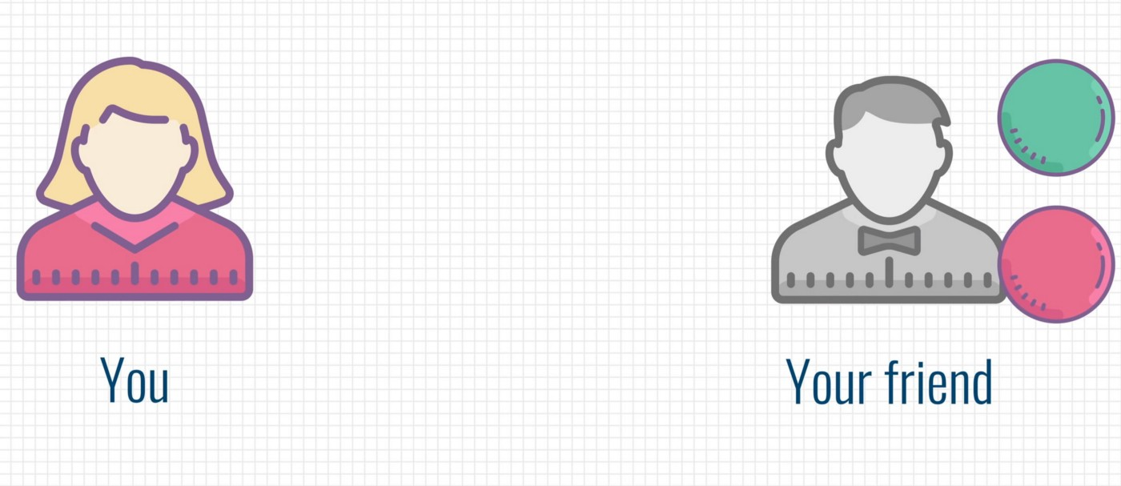
How does ZKPs work? Color Blind Friend and 2 Balls
A popular example to illustrate the basic idea behind ZKPs is as the following:
Suppose you (the prover) have a color-blind friend (the verifier) that cannot distinguish a green and a red ball from each other (have zero knowledge about whether the balls are different colors). You need to prove that the colors of the balls are different but your friend needs something more than your words to be convinced. A ZKP method for this problem would be like this:
Your friend takes the balls and lets you see which ball is in which hand.
Then, they either switch the balls between their hands or not behind their back.
They then present the balls to you and asks you whether they switched the balls or not. As you can distinguish the green ball from the red one, you can easily give the correct answer.
Your friend is not convinced. You have a 50% chance to correctly guess whether they switched the balls or not and the balls can still be the same color.
However, if they repeat this several times, eventually, the probability of you correctly guessing whether they switched the balls or not each time would be very low. This enables your friend to verify that the balls are different colors without knowing the actual colors of the balls.
A series of cryptographic algorithms are used in the real-world applications of ZKPs to enable the verification of a computational statement. For instance, using ZKP methods, a receiver of payment can verify that the payer has sufficient balance in their bank account without getting any other information about the payer’s balance.

Slide 11
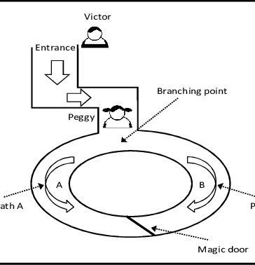
How Does ZKPs Work Ali Baba Cave
Ali Baba’s cave is a classic representation of the ideas of zero-knowledge proof presented by Quisquater et al. in their paper “How to Explain Zero-Knowledge Protocols to Your Children”. In this analogy, there is a circular cave with an entrance on one side and a magic door inside the cave blocking the opposite side. The first party, the prover, Peggy, possesses the secret word to open the magic door in the circular cave and wants to prove to second party, the verifier, Victor, that she really knows the secret word that can open the magic door, without revealing the secret itself.
Peggy goes into the cave to the branching point of the two paths (A and B) while Victor waits outside.
Peggy randomly selects path A or B and goes to the magic door while Victor goes into the cave to the branching point of the two paths.
Victor calls out a random path of the cave (A or B), where Peggy should come out.
Peggy can come out from the correct path every time if she knows the secret word to open the door, as she can open and pass the magic door with the secret word if necessary. If she doesn’t have the secret word, she has a 50% probability of coming out from the wrong path because she cannot pass the magic door. In the latter case, Victor will call her on a cheat the cheater.
Peggy and Victor repeat these steps as many times as required to convince Victor. If, after many repetitions, Peggy comes out from the correct path each time, Victor can be convinced that Peggy possesses the secret word to open the magic door.

Slide 12
Properties of ZKPs
A zero-knowledge proof (ZKP) method must satisfy these criteria:
Completeness: If the information provided by the prover is true, then a ZKP method must enable the verifier to verify that the prover is telling the truth.
Soundness: If the information provided by the prover is false, then a ZKP method must allow the verifier to refute that the prover is telling the truth.
Zero-knowledge: The method must reveal to the verifier nothing else than whether the prover telling the truth or not.

Slide 13
Types of ZKPs
Interactive zero-knowledge proofs (IZKPs): In this type of ZKPs, the prover and the verifier interact several times. The verifier challenges the prover who provides replies to these challenges until the verifier is convinced.
Non-interactive zero-knowledge proofs (NIZKPs): In this type of ZKPs, proof delivered by the prover can be verified by the verifier only once at any time. This type of ZKPs requires more computational power than interactive ZKPs. E.g zk-Snark, zk-Stark

Slide 14
How IZKPs Work
IZKPs requires interaction Commitment, Challenge and Response between Prover and Verifier,
IZKPs need the Verifier to be available (online) and have an interaction with the Prover to complete the proof generation. Besides Verifier is not be available (online) during the proof generation; the interactive proof systems require more rounds that bring overhead to the system.

Slide 15
ZKP Example (Discrete logs)
With Zero-knowledge proof (ZKP) we can prove that we know something without revealing our information. Bob and Alice know g and p (a prime number), and Alice wants Bob to prove he knows x. For this he creates a random value (r)
When our banks ask for our second, third and fifth letter of our password, we are giving away our password. Slowly we will reveal the whole password. Surely there must be better ways of proving that we know something, without revealing what we know?
We could use some fancy encryption keys, but can we do better with a bit of maths? For this we turn to logs, and derive things from the work of John Napier.
There are many applications in proving things without revealing the information that you are proving. This could be to prove your identity or even your date of birth. Overall, this is defined as Privacy Enhancing Technologies (PET), and where we can reveal information without revealing our answer.
In cryptography, let's say that Alice wants to prove that Bob knows a value (x), such: g^x mod P=Y
Where g is a pre-selected value, P is a prime and Y is a result. Both Bob and Alice know these values, and it's difficult to know the value of x, as there are many values of x that would fit.
To prove that Bob knows the value of x, he creates a random number (r) and sends the result of this calculation to Alice: C = g ^ r mod P
He then sends: Cipher1 = g^((x+r) mod (P-1)) mod P
Alice Calculates: Cipher2 = C.Y mod P
If the values are the same (Cipher1 = Cipher 2), Bob proves that he knows the secret x
Notes:
import sys
p=71
g=13
x=7
r=8
print ('p=',p)
print ('g=',g)
print ('x=',x)
print ('r=',r)
print ('========')
y= g**x % p
print ('Y=',y)
C = g**r % p
print ('C=',C)
print ('========')
val1=g**((x+r)%(p-1)) % p
print ('g^(x+r)%(p-1) mod p=',val1)
val2=C*y %p
print ('C.y mod P=',val2)
if (val1==val2):
print ('Well done ... have you proven that you know x')
else:
print ('Not proven’)
### https://replit.com/@billbuchanan/z

Slide 16
HOW NIZKPs Work
NIZKPs are usually built in two main models, known as Random Oracle (RO) or Common Reference String (CRS)
In a Random oracle model all parties has access to a one-way function (oracle) that responds to every unique query with a (truly) random response chosen uniformly from its output domain. If a query is repeated, it responds the same way every time that query is submitted. a random oracle is a mathematical function chosen uniformly at random, that is, a function mapping each possible query to a (fixed) random response from its output domain.
The random oracle model assumes a publicly-accessible oracle (“black box”) that everyone can access. This oracle is assumed to implement a completely random function. In practice (random oracles do not exist in the real world!), we will instantiate the random oracle with a cryptographic hash function. From a theoretical point of view: no (efficiently-computable) hash function can possibly be a random function! (A true random function would have a description that is exponentially large!) From a practical point of view: better to have a construction which can be proven secure in the random oracle model than to have a construction with no proof at all. In practice: if an adversary can break a scheme which was proven secure in the random oracle model, then the hash function used to instantiate the random oracle must not be “good enough”. So, a proof of security in the random oracle model gives us confidence in the scheme, since it seems that the only way to break the scheme (in the real world) involves finding some weakness in the hash function used to instantiate the random oracle. In theory: no formal statement along these lines seems possible. It might be possible to break a scheme which was proven secure in the random oracle model without finding any specific weakness in the hash function used. Furthermore, there are (artificial) examples of schemes that can be proven secure in the random oracle model, but which are insecure when the random oracle is replaced by any specific hash function.
To summarize: a proof of security in the random oracle model is no guarantee of any security in the real world; on the other hand, a proof of security in the random oracle model is better than no proof at all, and the only efficient schemes we (currently) know how to construct are provably secure only in the random oracle model. So if we want efficient schemes with some evidence (but not guarantee!) of their security
In the CRS model where there is a public string that was generated in a trusted manner, and all parties have access to the string. It has two flavors: a common random string (where it is just a uniformly distributed string) and a general common reference string (which may have an arbitrary distribution).
The main difference between the ROM and CRS model is that proofs in the ROM are heuristic, since the actual protocol instantiation uses a hash function. In contrast, proofs in the CRS model have a standard reduction-based proof of security, and so are not heuristic.
The main advantage of the CRS model over the random oracle model is that security is standard and doesn't rely on a heuristic belief system that the real protocol that uses a standard hash function is secure. The main disadvantage is that you need to somehow generate this CRS, and this isn't trivial if there's no trust. Zcash uses a CRS and ran a large MPC protocol between many parties to generate the CRS. As long as you believe that not all the participants colluded, then you can trust the system from that point on. This is a good example of where a CRS can be deployed in reality.
The CRS model there exists a trusted setup in which all involved parties get access to the same string CRS taken from uniform distribution of bit strings that generates some public parameters that will be used by the Prover and Verifier for proof generation and proof verification

Slide 17
Zk-Snarks
zk-SNARK proofs are dependent on an initial trusted setup between a prover and verifier, meaning that a set of public parameters is required to construct zero-knowledge proofs and, thus, private transactions. These parameters are almost like the rules of the game, they are encoded into the protocol and are one of the necessary factors in proving a transaction was valid. However, this creates a potential centralization issue because the parameters are often formulated by a very small group. They are not quantum resistant.
zk-STARKs do not require an initial trusted setup they rely collision-resistant hash functions. They are quantum resistant. STARKs have far larger proof sizes than SNARKs, which means that verifying STARKs takes more time than SNARKs
Notes:
In cryptography, collision resistance is a property of cryptographic hash functions: a hash function H is collision-resistant if it is hard to find two inputs that hash to the same output; that is, two inputs a and b where a ≠ b but H(a) = H(b)

Slide 18
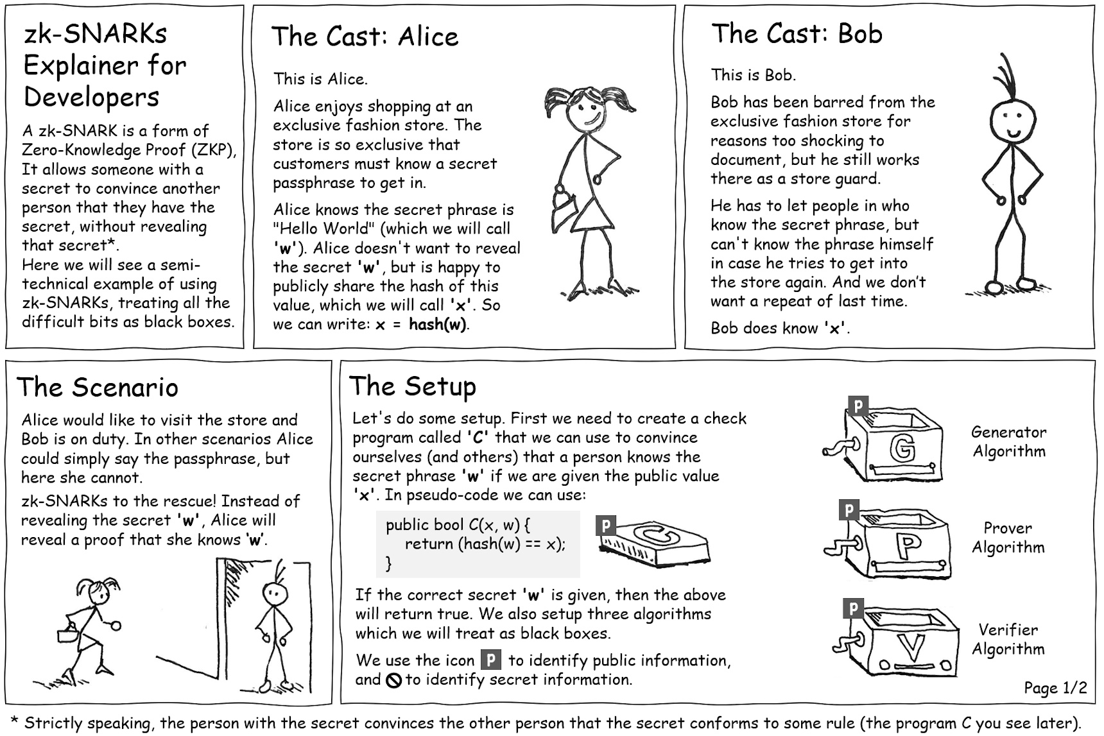

Slide 19
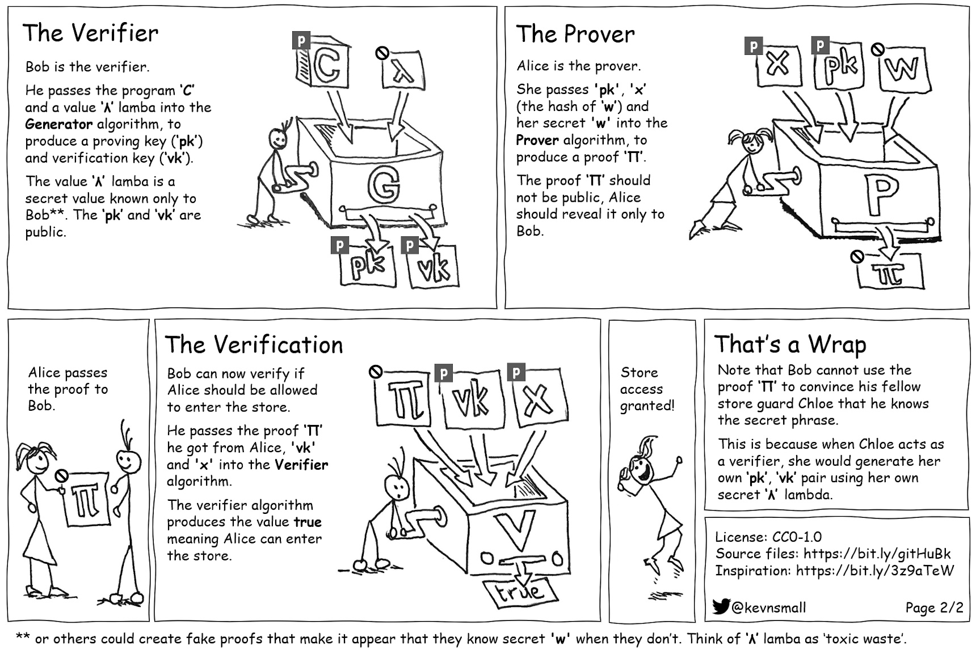

Slide 20
What are Challenges of ZKPs
No 100% guarantee: Even if the probability of verification by the verifier while the prover is lying can be significantly low, ZKPs don’t guarantee that the claim is valid 100%. As demonstrated above, the probability of a prover lying decreases in each iteration of the ball-picking process, but it can never reach zero. Thus, zero-knowledge proofs aren’t actual proofs in a mathematical sense.
Computation intensity: Algorithms used are computationally intense as they require many interactions between the verifier and the prover (in interactive ZKPs) or require a lot of computational capabilities (in non-interactive ZKPs). This makes ZKPs unsuitable for slow or mobile devices.

Slide 21
Fiat-Shamir with a Secret Password
In Zero-Knowledge Proofs (ZPFs), Peggy (the prover) proves to Victor (the verifier) that she knows a secret. With Fiat–Shamir we can prove that we know a value without actually revealing the orginal value. In the following Peggy will prove to Victor that she knows her password and thus a secret value of x. Peggy thus generates a random number (v) and Victor generates a random value (c) for a challenge

Slide 22
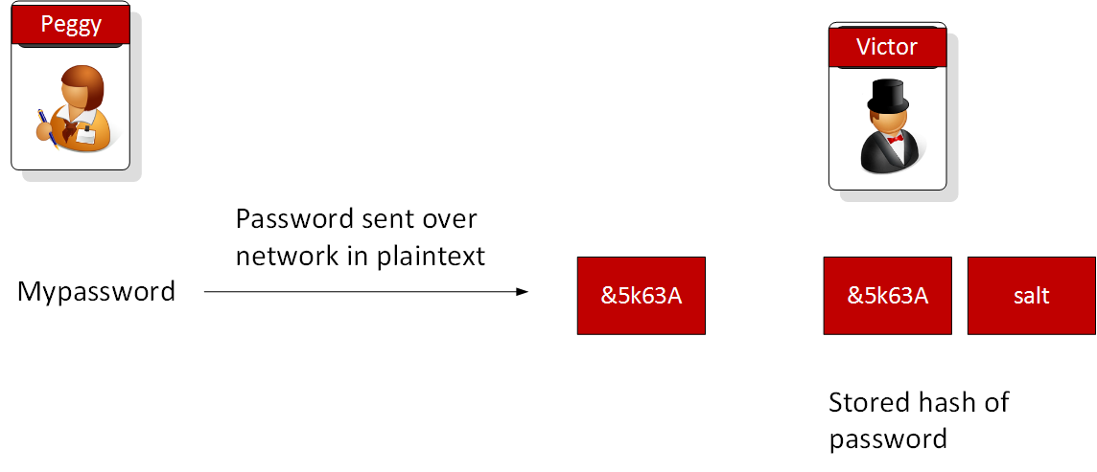
Fiat Shamir with a Secret-Problem
Problem
So let’s define the problem we want to solve. Basically, can I prove my password, that me and my Cloud service provider have agreed, but for me not to actually tell them what it is? Most of the time, though, I have to give my service provider my password, and then they hash it, and check against the hash that they have. We have thus become sheep, where we blindly fall down the same trap, again and again.
And so we have Peggy (the Prover) sending her password to Victor (the Verifier), and who will take the salt we have on the password, and then take Peggy’s password, and compute a hashed value for it. If the hashed value is the same as the hash stored on his system, then Victor has verified Peggy. How can something so simple lead to billions of passwords being released?
What a crazy system! Peggy is forced to give away her password every time, and Victor now has stored the salt with the hashed value, so that Eve can come along and try lots of possible passwords for Peggy, and then discover her password. Eve might then go and try other systems that Peggy uses, and crack them. Victor might not even know that Eve is doing this, as she can take all the hashed password off-line, and she can continually try possible passwords.
It is complete rubbish, and not fit for a world where Peggy is the true owner of her data and identity, and that Victor has no rights to know her sensitive information (like her password)! It is a system which worked in the 1980s, when we had computers that ran with clock speeds of 16MHz and which had 16MBs of memory, but doesn’t work in a modern era building with the computation power of The Cloud. The hard problem of cracking hashes in the 1980s, is certainly not so difficult in a era of almost endless computing power.

Slide 23
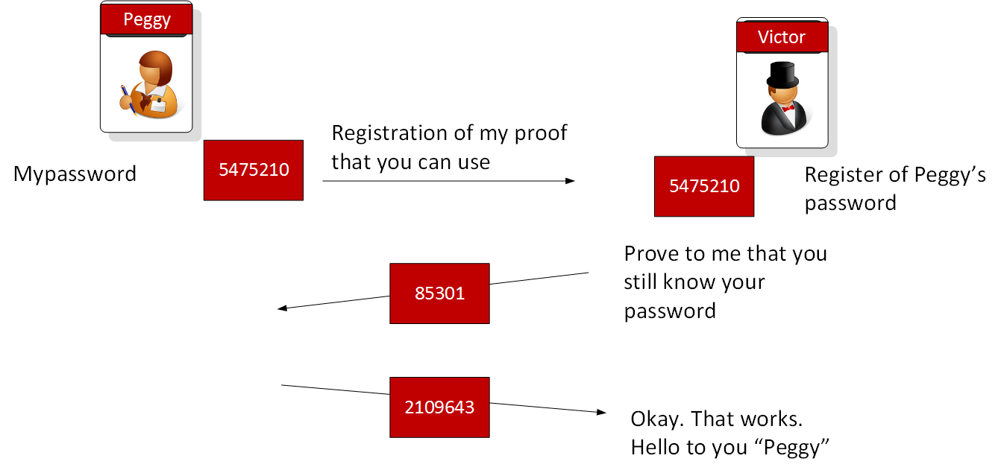
Fiat-Shamir with a Secret - Solution
What we need is a way that Peggy can generate her own password, and then register something with Victor so that he can generate a challenge to her to prove that she still knows it. This sounds, oh so simple, but we blindly still go down the same route of giving away our passwords for the systems that we build. For this we need Zero Knowledge Proofs (ZKPs), and we make sure that the registration process done in a way that has high levels of trust.
Now Peggy can generate an initial registration value, and which Victor can store. We will make sure that it is almost impossible to ever determine her original password from the registration value we use. Now, when Peggy wants to log in to Victor’s system, he sends her a random challenge, and she must produce the right answer to show that she still knows her password. If she return the right answer, Victor lets her log in. Every time Peggy wants to log in Victor sends her different head
There are many ways to solve the problem, but one of the most widely used methods is the “non-interactive random oracle access” for zero-knowledge proofs. It is defined as the Fiat-Shamir heuristic. It uses discrete logarithms to create a difficult puzzle for Eve, and an easy one for Peggy to prove, and for Victor to verify. Eve, with her array of GPU crackers, will have an extremely large electricity bill if we make the puzzle so difficult that she’ll be have to consume masses of computing power, just to solve one element of the puzzle

Slide 24
Fiat-Shamir with a Secret
First Victor and Peggy agree on a generator value (g) and a prime number (p)
First Peggy decides on her password (pass), and generates a hash of it, and then converts this to an integer value (x). x = Hash(pass), y=g^x and to make things more difficult and to allow us to create the puzzle we need to pick a prime number (p) and make the operation: y=g^x (mod p) Peggy sends Victor the value of y, and he stores it.
Now Peggy wants to log on, so she send generates a new random number and sends Victor has value of t which is t=g^v
Victor thens sends her a challenge ( c ) and which is a random value that he has now used before
Peggy generates another random value (v), and now takes the c value, and computes r=v-c x t and sends Victor the value of r
Victor computes val = g^c y^c and checks if the result equals t equals val, and if they are the same, Peggy has proven her identity, and Eve is left scratching her head
Note that the operations are conducted with (mod p) and it works because of the magic is logarithms: g^r×y^c=g^(v−cx)×g^xc=g^(v−cx+cx)=g^v
For a password reset, Peggy just contacts Victor and does some multi-factor authentication that she did when she registered her secret, and then registers a new secret.
Notes:
import sys
import random
import hashlib
import libnum
n=997
text="Hello"
g= 3
def pickg(p):
for x in range (1,p):
rand = x
exp=1
next = rand % p
while (next != 1 ):
next = (next*rand) % p
exp = exp+1
if (exp==p-1):
return rand
v = random.randint(1,n)
c = random.randint(1,n)
if (len(sys.argv)>1):
text=str(sys.argv[1])
if (len(sys.argv)>2):
v=int(sys.argv[2])
if (len(sys.argv)>3):
c=int(sys.argv[3])
if (len(sys.argv)>4):
n=int(sys.argv[4])
print("Password:\t",text)
x = int(hashlib.md5(text.encode()).hexdigest()[:8], 16) % n
g=pickg(n)
y= pow(g,x,n)
t = pow(g,v,n)
r = (v - c * x)
if (r<0):
Result = ( libnum.invmod(pow(g,-r,n),n) * pow(y,c,n)) % n
else:
Result = ( pow(g,r,n) * pow(y,c,n)) % n
print('\n======Agreed parameters============')
print('P=',n,'\t(Prime number)')
print('G=',g,'\t(Generator)')
print('\n======The secret==================')
print('x=',x,'\t(Alice\'s secret)')
print('\n======Random values===============')
print('c=',c,'\t(Bob\'s random value)')
print('v=',v,'\t(Alice\'s random value)')
print('\n======Shared value===============')
print('g^x mod P=\t',y)
print('r=\t\t',r)
print('\n=========Results===================')
print('t=g**v % n =\t\t',t)
print('( (g**r) * (y**c) )=\t',Result)
if (t==Result):
print('Alice has proven she knows password')
else:
print('Alice has not proven she knows x’)
# https://replit.com/@billbuchanan/zktut2

Slide 25
Fiat-Shamir with a Secret - Conclusion
And that is it. Eve does not have the computing power to work out Peggy’s password, and Victor doesn’t know it either. That is a world that puts Peggy at the centre, and pushes Victor to the edge.
We need to move to a world where we respect citizen’s rights to privacy, and a core part of this is to allow them to preserve the data that they do not want known. For passwords, we still live in the 1980s, and we blindly build systems which give away a great deal of our most sensitive information. For Victor and Eve, that is fine, but, increasingly our world should be build for Peggy, and not Victor or Eve.
A world for Peggy, and leave Eve with a massive electricity bill. For Victor, those who will change their ways, will benefit most from the new world that we are building. And for those Victor’s who stay the same, they will go the way of the dinosaurs. A new era begins

Slide 26
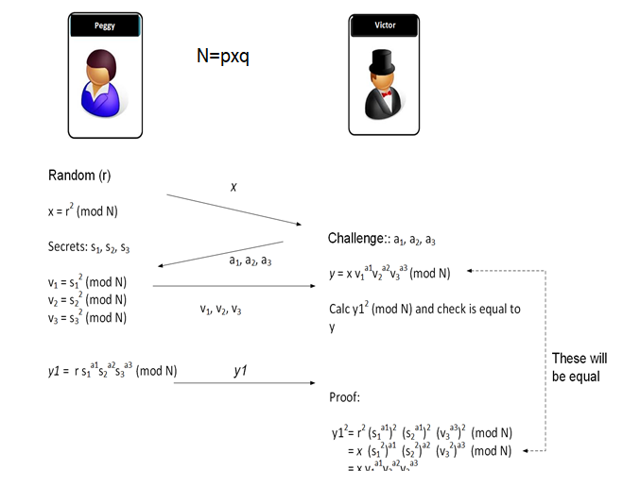
Fiat-Feige-Shamir ZKP
Why do we still pass our passwords over a network? Why do we still hash passwords? Why can’t we come up with our own random value, and then prove to everyone that we know the secret?
Well, the Feige-Fiat-Shamir method provides a zero-knowledge proof — created by Uriel Feige, Amos Fiat, and Adi Shamir in 1988 [paper] — and where Bob can prove something to Alice, without revealing the information that he has.
First Peggy (the prover) and Victor (the verifier) agree on two prime numbers (say 101 and 23), and calculate a value of N (101𝗑23), to give N=2,323.
Peggy has three secret numbers of s1=5; s2=7; and s3=3. Note that these numbers need to be co-prime to N, so that they do not share a factor with n. If we choose N as the multiplication of two prime numbers, we only need to avoid these numbers.
Now Victor generates three random numbers which are either 0 or a 1, such as a1=1; a2=0; and a3=1, and sends these to Peggy.
Next Peggy generates a random number (such as r=13). She then calculates a value of x which is:
x = (r^2) % n
which gives x = 169. Peggy sends this to Victor.
Peggy calculates:
y1 = (r * ((s1^a1) * (s2^a2) * (s3^a3)) ) % n
This gives 195, which she sends to Victor.
Next Peggy then computes:
v1=(s1^2) % n v2=(s2^2) % n v3=(s3^2) % n
She then sends these to Victor and who computes:
y = (x * ( (v1^a1) * (v2^a2) * (v3^a3)) ) % n
If (y1² mod n) is equal to y that Peggy has sent, then Peggy has proven that she knows the secret values.
Notes:
n=101*23
r=13
s1=5
s2=7
s3=3
a1=1
a2=0
a3=1
print ('N=',n)
x = (r**2) % n
print ('x=',x)
print ('s1=',s1,'s2=',s2,'s3=',s3)
print ('a1=',a1,'a2=',a2,'a3=',a3)
y = (r * ((s1**a1) * (s2**a2) * (s3**a3)) ) % n
print ('Y=',y, ' y^2 mod n = ',(y**2 % n))
v1=(s1**2) %n
v2=(s2**2) %n
v3=(s3**2) %n
y2 = (x * ( (v1**a1) * (v2**a2) * (v3**a3)) ) % n
print ('Y=',(y**2) %n)
“”” N= 2323
x= 169
s1= 5 s2= 7 s3= 3
a1= 1 a2= 0 a3= 1
Y= 195 y^2 mod n = 857
Y^2= 857
“””
#### https://replit.com/@billbuchanan/z2

Slide 27
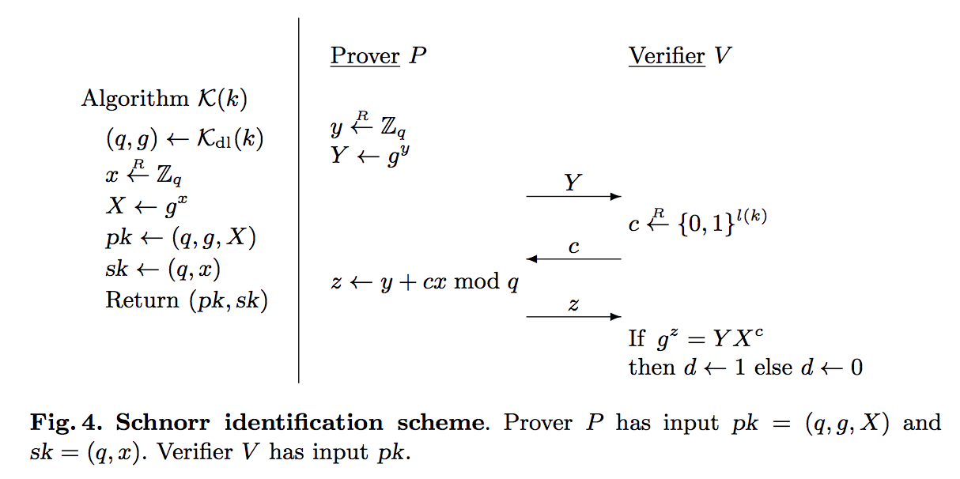
Schnorr ZKP
It uses discrete logarithms. The prover (Peggy) has a proving public key of (g,X) where g is a generator, and X=g^x(mod N). x is the secret value that the prover (Peggy) must prove. After Peggy generates her public proving key, she will then be challenged by Victor to produce the correct result. In the following we define a secret value (x), a generator (g) and a modulus value (N).
With Schnorr identification, Peggy (the prover) has a proving public key of (N,g,X) and a proving secret key of (N,x). N is a prime number for the modulus operation, and x is the secret, and where:
X←g^x(modN)
On the registration of the secret, Peggy generates a random value (y), and then computes Y:
Y←g^y(modN)
This value is sent to Victor (who is the verifier). Victor then generates a random value (c) and sends this to Peggy. This is a challenge to Peggy to produce the correct result. Peggy then computes:
z←(y+xc)(modN)
He then sends this to Victor in order to prove that he knows x. Victor then computes two values:
val1=YX^c(modN)
val2=g^z(modN)
If the values are the same (val1≡val2), Peggy has proven that she knows x.
This works because:
YX^c=g^y g^xc=g^y+cx
gz=g^y+cx
Notes:
import random
import sys
N=89
g=3
x = random.randint(1,97)
X = pow(g,x) % N
y = random.randint(1,97)
Y = pow(g,y) % N
print("Peggy (the Prover) generates these values:")
print("x(secret)=\t",x)
print("N=\t\t",N)
print("X=\t\t",X)
print("\nPeggy generates a random value (y):")
print("y=",y)
print("\nPeggy computes Y = g^y (mod N) and passes to Victor:")
print("Y=",Y)
print("\nVictor generates a random value (c) and passes to Peggy:")
c = random.randint(1,97)
print("c=",c)
print("\nPeggy calculates z = y.x^c (mod N) and send to Victor (the Verifier):")
z = (y + c * x)
print("z=",z)
print("\nVictor now computes val=g^z (mod N) and (Y X^c (mod N)) and determines if they are the same\n")
val1= pow(g,z) % N
val2= (Y * (X**c)) % N
print("val1=\t",val1, end=' ')
print(" val2=\t",val2)
if (val1==val2):
print("Peggy has proven that he knows x")
else:
print("Failure to prove")
### https://replit.com/@billbuchanan/pyschnorr#main.py

Slide 28
Discrete Log
Suppose that G is a group and g ∈ G has finite order m. Then for each t ∈ <g> the integers n with g^n = t form a residue class mod m. Denote it by logg t. The discrete logarithm problem is the computational task of finding a representative of this residue class; that is, finding an integer n with g^n = t.
Finding a discrete logarithm can be very easy
Lets make it harder: take g as some other generator of Z/m Z. But then computing logg t is really solving the congruence ng ≡ t mod m

Slide 29
zkSnark (Homomorphic Hiding)
With HH we aim to prove that Alice knows two values (x, y) to equal a given answer (ans). Alice will pass the encrypted values for x and y, and Bob will verify that the sum is equal to an encrypted value of the answer (ans)
Let's say you want to prove that Alice can produce two number which adds up to 8. How does Bob prove that she knows them, without knowing the numbers that she picks? This method is the core of zkSNARK and overcomes the major problem of Blockchain - which is the lack of privacy in computations and transactions. They are used in zCash, and now being considered in several application areas around blockchain technology, as they can hide the entities, data and transaction details.
The core element of the method is the usage of HH (Homomorphic Hiding), and which allows us to perform a mathematical operation on encrypted values. For example, if we have a value x and a value y, and we want to encrypt them we get E(x) and E(y)
Now with homomorphic encryption we can take the encrypted values and multiply them to get the addition E(x+y) = E(x) x E(y)
We can perform this with discrete logs and where: E(x+y)=g^(mod p-1) equals to E(x+y)=g^x g^y
Alice encrypts x at g^x, and y with g^y, then multiply values to get E(x+y)
If Bob wanted to know if x + y=8, Bob will Encrypt E(8) and check if they are the same
Notes:
import sys
import random
n=101
g= 3
ans=7
x = 3
y = 4
E1= g**( (x+y) % (n-1)) % n
E2= (g**x * g**y) % n
E3 = g**(ans) % n
print('======Agreed parameters============')
print('P=',n,'\t(Prime number)')
print('G=',g,'\t(Generator)')
print('x=',x,'\t(Value 1 - Alice first value)')
print('y=',y,'\t(value 2 - Alice second value)')
print('ans=',ans,'\t(Answer = x+y?)')
print('======Encrypted values============')
print('g^x=',(g**x) % n)
print('g^y=',(g**y) % n)
print('======zkSnark====================')
print('E1=',E1)
print('E2=',E2)
print('E3=',E3)
if (E2==E3):
print('Alice has proven she knows the sum is ',ans)
else:
print('Alice has proven she does not know the sum is ',ans)
### https://replit.com/@billbuchanan/zksnark01

Slide 30
zkSNARK (Blind evaluation problem)
With the Blind evaluation problem Bob doesn't want Alice to known the values that he is using and Alice doesn't want Bob to know the method she is using to compute a result. For this we use zkSNARK. In this case the equation is P(x)=ax+bx^2
In the blind evaluation problem, we do not want Bob to determine the method we are using to implement a given function, but we want him to know the result with a value of s. Then although we get Alice to compute the result, she will not know s.
For this we use polynomials, and where we have an equation such as: P(x)=a0 + a1x + a2x^2
Bob sends all the elements - known as hidings - of the computation for a value of s: E(a0), E(a1 x s) and E (a2 x s^2)
Alice will not know the value of s used, but she knows the "wiring" of the function. In this case she knows that it is a simple adding operation, so she can compute using Homomorphic encryption E(P(s))=E(a0)+E(a1×s)+E(a2×s^2)
She can do this because E(ax+by)=g^(ax+by)=g^(ax)⋅g^(by)=(g^x)a⋅(g^y)b=E(x)a⋅E(y)b
So Alice, who knows a and b, can simply raise the values received to the polynomial factors and multiply and return to Bob. Bob then knows the answer, but Alice doesn't know the value of s used.
With Blockchain we cannot hide the identities involved in a transaction and the code the implement, thus we can tell how many bitcoins that Bob has in his account and all the transaction values. With zkSNARK we can hide the values used within computations on the blockchain.
Notes:
# Here is some sample code for an equation of ax+bx^2
import sys
import random
n=101
g= 3
x=5
a = 3
b = 4
# eqn = ax + b x^2
E1= pow(g,( a *x ) ,n)
E2= pow(g,(b*x*x),n)
E3 = (E1 * E2) % n
E4 = pow(g,(a*x + b*x*x) , n)
print('======Agreed parameters============')
print('P=',n,'\t(Prime number)')
print('G=',g,'\t(Generator)')
print('a=',a)
print('b=',b)
print('x=',x,'\t(Eqn= ax + bx^2)')
print('======zkSnark====================')
print('E3=',E3)
print('E4=',E4)
if (E3==E4):
print('Alice has computed the result')
else:
print('Alice has proven she does not know result’)
#### https://replit.com/@billbuchanan/zksnark02
“””
Alice gets sent E1 and E2 and then she adds then (which is a multiplication with discrete logarithms), and sends E3 back. This is the result of E(3x+4x2) for a value of x = 5. Alice does not know the value of x, and Bob doesn't know how Alice did the computation.
“””

Slide 31
Sources
Asecuritysite – Prof. Bill Buchanan
Aimultiple – Cem Dilmegani

